Slide 1

Exploring Micromobility and Factors in Growth and Success of the Programs

Slide 2
What is Micromobility?
Micromobility represents simple and convenient methods of transportation to get around a town or city, including bikeshare and scooter programs
These forms of travel can help combat traffic congestion and pollution in cities
The global micromobility market was estimated to be about $44 billion in 2020 and projected to grow to over $214 billion by 2030
Many large cities have implemented micromobility programs, including New York City, Chicago, Austin, and Los Angeles

Slide 3
Data Overview and Elements
The data is typically made publicly available and represents one row per trip, such as a bike trip from point ”A” to point “B”
Each city can have millions of rows per year
The data elements typically include:
Date/time of departure
Departure Location (Station Name and/or latitude & longitude coordinates)
Date/time of arrival at destination
Destination Location (Station Name and/or latitude & longitude coordinates)
Type of transport used -- Pedal bike, e-bike, electric scooter
Type of customer - daily, monthly pass

Slide 4
Additional Data
Additional datasets will be used and analyzed in conjunction with the micromobility data, including:
U.S. Bureau of Transportation Statistics: https://data.bts.gov/stories/s/fseh-ipec
Unemployment data: https://www.bls.gov/bls/unemployment.htm
Demographic data: https://www.bls.gov/bls/demographics.htm
Wage information: https://www.bls.gov/bls/wages.htm

Slide 5

Research Questions
Are there specific economic/socio-economic factors that impact the usage of micromobility (unemployment rates, poverty rates, crime)?
Does geographic location impact the likelihood of success of a micromobility program (warm/cold, hilly/flat)?
Do demographics have an impact on growth and usage of micromobility (age or population)?
Are there seasonal patterns in the usage of micromobility?
Are there differences in usage patterns based on the types of micromobility (pedal bikes vs e-bikes vs scooters)?
Can growth or usage patterns in micromobility be predicted through machine learning techniques? Which models perform best?
Could machine learning be used to identify other cities where micromobility programs would have a high likelihood of success?

Slide 6
Research Process
Obtain and clean data from multiple city micromobility programs and supplemental data (unemployment rates, demographics)
Perform Exploratory Data Analysis to obtain an understanding of the data, trends, distributions.
Leverage the use of charts and visualizations to help gain insights into the data.
Identify key features/attributes within the datasets to use in machine learning (ML) models tha may be useful to predict usage and growth patterns.
Train and test different ML models and evaluate the accuracy of predictions with different groups of features and city data.
Evaluate results to conclude on hypotheses and research questions.

Slide 7
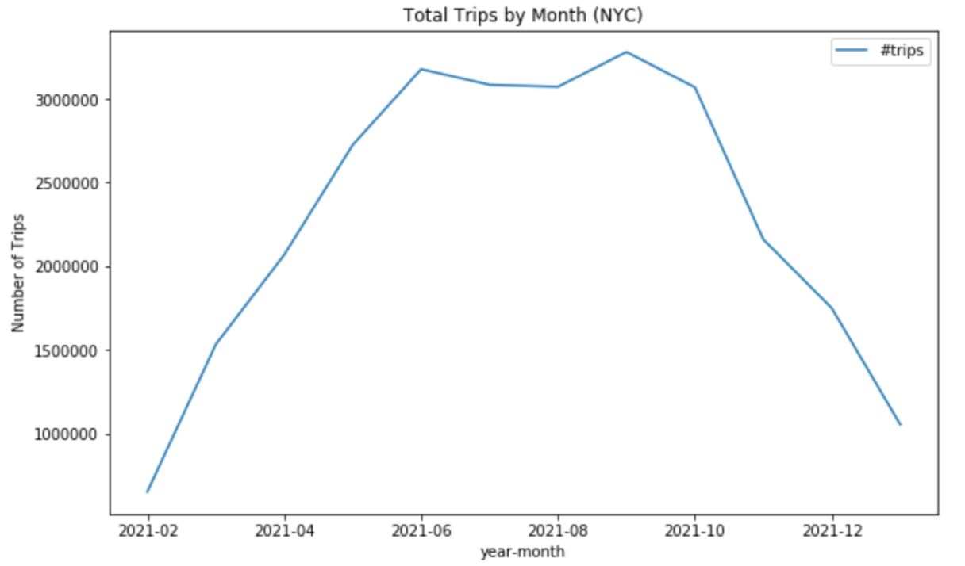
Initial EDA - New York City Basics
27.6 million trips in the 12 months from February 2021 through January 2022
Peak usage during summer months
1586 different Start Stations from which trips originated

Slide 8
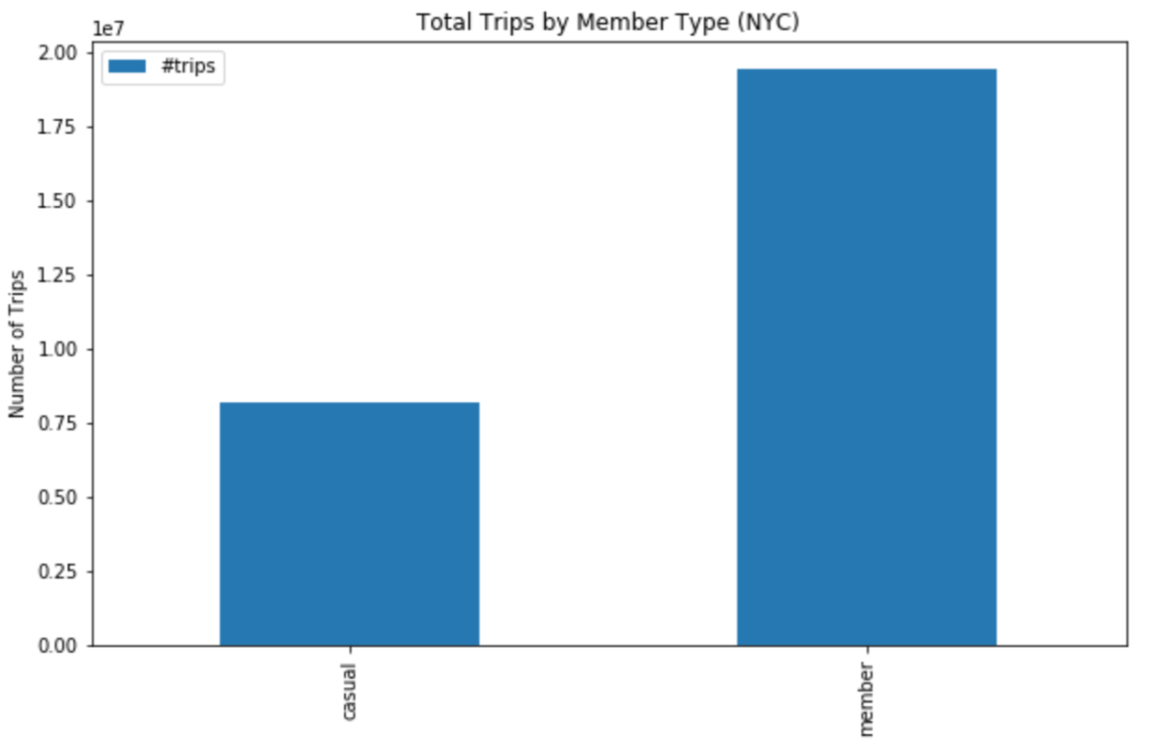
Initial EDA - New York City Basics
Large majority of customers were members (have an account). The remaining are casual customers (such as those that pay per trip)
Two thirds of trips used dockless pedal bikes and the remaining was docked bikes.
A miniscule amount used e-bikes as the program has very few at this point.

Slide 9
Next Steps in EDA
The time period will be expanded significantly from this single year period. That is, the analysis will expand to at least 3 years of data. That may amount to about 80 million records just for NYC.
Expanding to at least 3 other micromobility programs for other cities. Differences between data elements tracked could present challenges in identifying common features for analysis and for applying machine learning models.
Demographic data for each city reviewed will also be analyzed (average age, income level, population size)
Other data related to economic conditions (such as unemployment rates) will also be obtained and analyzed in conjunction with the micromobility data.

Slide 10
Machine Learning Models
K-Nearest Neighbor (KNN) – KNN can be used for time series analysis and forecasting. Research has been performed on the use of KNN for things like forecasting GDP growth.
ARIMA – This model provides unique benefits for forecasting based on time series data. One example used it to forecast inflation in Ireland.
Random Forest – This has been shown to be beneficial with large datasets with many attributes.
Naïve Bayes – This is relatively simplistic model that has been found to be useful for prediction in a wide range of areas. Plan to develop categories to measure success, such as ranges of growth, and predict percentage of growth in the future.
Long Short-Term Memory (LSTM) Neural Network – LSTM has been found to be suitable for time series based forecasting with multivariate input.
Least Squares Support Vector Machine (LS-SVM) – This model has been found to be useful in various forecasting applications, including traffic forecasting

Slide 11
Expected Results & Outcomes
Although there is much more work to be done before conclusions can be reached, these are some early thoughts:
Intend to better understand usage patterns of micromobility and which factors are most relevant to predict usage, growth, and the success of micromobility programs.
Ideally, this research will help in evaluating and identifying other cities that could benefit most from micromobility programs, and be successful.

Slide 12
References / Sources
Market background: https://www.alliedmarketresearch.com/micro-mobility-market-A11372#:~:text=The%20global%20micromobility%20market%20was,17.4%25%20from%202021%20to%202030
New York City Data: https://ride.citibikenyc.com/system-data
J. Du, Q. Liu, K. Chen and J. Wang, "Forecasting stock prices in two ways based on LSTM neural network," 2019 IEEE 3rd Information Technology, Networking, Electronic and Automation Control Conference (ITNEC), 2019, pp. 1083-1086, doi: 10.1109/ITNEC.2019.8729026.
Jönsson, Kristian. "Machine learning and nowcasts of Swedish GDP." Journal of Business Cycle Research 16.2 (2020): 123-134.
I. Kumar, K. Dogra, C. Utreja and P. Yadav, "A Comparative Study of Supervised Machine Learning Algorithms for Stock Market Trend Prediction," 2018 Second International Conference on Inventive Communication and Computational Technologies (ICICCT), 2018, pp. 1003-1007, doi: 10.1109/ICICCT.2018.8473214.
Meyler, Aidan, Geoff Kenny, and Terry Quinn. "Forecasting Irish inflation using ARIMA models." (1998): 1-48.
Zhang, Yang, and Yuncai Liu. "Traffic forecasting using least squares support vector machines." Transportmetrica 5.3 (2009): 193-213.

